Slide 1
The CITE Initiative
Collaborative Inquiry Team in Education
Phase 1: January-June 2015
Phase 2: January-June 2016
Presenters: Maria Cantalini-Williams, Debra Curtis, Kim DeGasperis,
Heather Papp, Sherrie Rellinger

Slide 2
Goals of CITE:
Develop a collaborative inquiry model with a concurrent research study
Align with Ontario Education Research Strategy http://www.edu.gov.on.ca/eng/research/strategy.html
Utilize School Board-University Research Exchange Network (SURE) resources: www.surenetwork.ca
Facilitate teacher efficacy and professional learning
Share and implement effective strategies to promote student learning as outlined in school plans
‘Name, Frame and Proclaim’ teacher research!

Slide 3
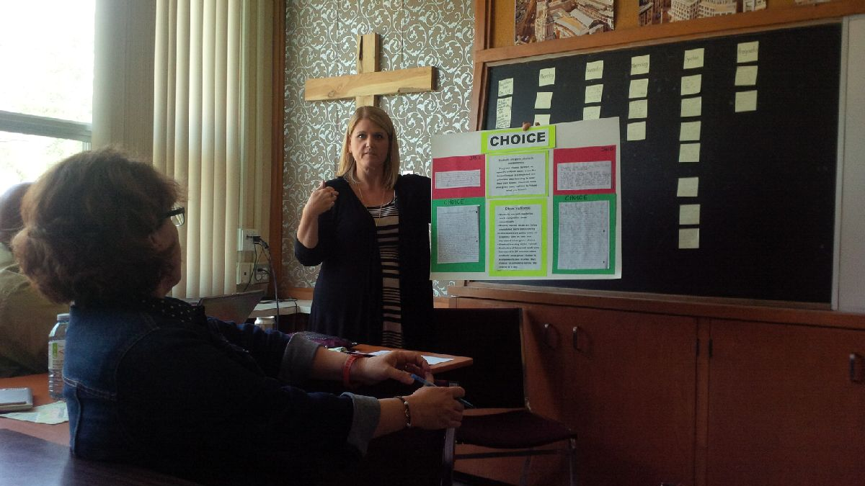
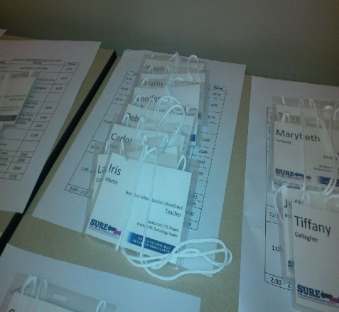
Teacher Researchers

Slide 4
Related Research
A culture of inquiry whereby research is valued, accessible to practitioners, relevant to particular contexts, and contributes to enhancing teaching to further student learning (Martinovic, Wiebe, Ratkovic, Willard-Holt, Spencer & Cantalini-Williams, 2012)
Teachers have been found to be ideal researchers as they are insightful and knowledgeable in regards to current teaching practices and student needs (Blakemore, 2012).
Partnerships are successful when universities, schools, and teachers work in collaboration to conduct meaningful research about current educational issues (Gore & Gitlin, 2004; Kyei-Blankson, 2014).
Cooper (2014) found that knowledge mobilization facilitates exchange between academic research and professional practice. Collaborative inquiry rarely used online strategies for discussion of information.

Slide 5
Development of CITE
Support from Board Superintendents to liaise with Student Work Study Teacher
Meetings with SWS teacher and school principal
Research ethics approval was received from university and school board
Sessions intended to build trust, norms and mutual understandings
CITE was not an additional workload
Alignment with the work of the SWS teacher in collaboration with SIPSA school team

Slide 6
Research Questions
How does the collaborative inquiry process facilitate participants’ awareness of and interest in the research process?
How does the collaborative inquiry process create a community of educational researchers?
How does the collaborative inquiry process contribute to increased competencies and changes in pedagogical practices?
How did the collaborative inquiry initiative enhance student learning and skills?
What are the enablers and challenges to developing collaborative inquiry teams in education?

Slide 7
Methodology
Nine Participants: 6 classroom teachers ( grades 1-7 with 2 males and 4 females), principal, SWS teacher and resource teacher)
Two faculty facilitators who had worked for WCDSB
Five monthly sessions
Each session included a range of activities such as SURE and Ministry videos, discussions, completing an Action Plan with focus and strategies, sharing pedagogical documentation and evidence of student engagement/learning
Professional development included: research process, effective teaching strategies, and cycle of collaborative inquiry

Slide 8
Collection of Data
A Qualitative Approach with Triangulation of Data
1. Transcriptions: A portion of each session was audiotaped to gather perceptions of benefits and challenges of the research process and the new learnings related to pedagogy and effective practice.
2. Reflection/Feedback: Forms were completed anonymously by each participant at the end of each session to provide direction and evidence of participants’ learning. Feedback used to plan following sessions.
3. Documents: Artifacts were created such as discussion charts, graphic organizers, action plans and student samples/pedagogical documentation.

Slide 9
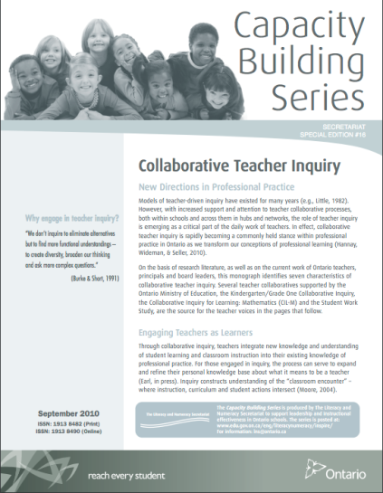
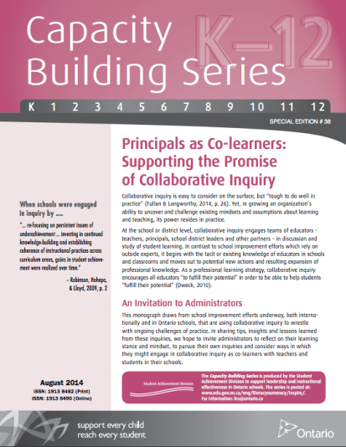
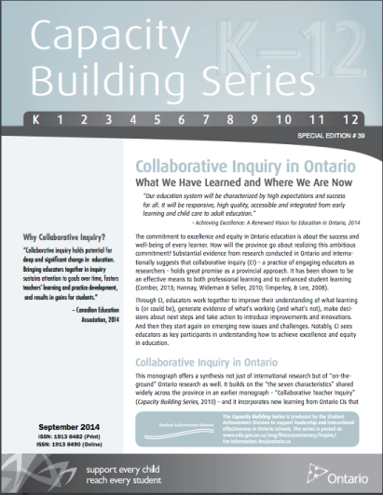
Principal as Co-Learner
Why St. Peter accepted invitation
How group was formed
Why we arrived at decision to use SIPSA as basis of CITE
Benefits for the staff, school, students…

Slide 10
St. Peter SIPSA Problem of Practice 2014-15

Slide 11
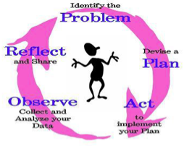
CITE Research Action Plan
Identify a Problem/Goal/Challenge
Develop a Plan or (Focus Question or Theory of Action)
Act and Implement Strategies
Observe and Collect Documentation/Data/Evidence
Reflect on Successes
and Share Effective
Strategies

Slide 12
Research Action Plan
Focus Question:
How can we foster an environment that is conducive to productive engagement for learning?
Teacher | Focus Area/Goal | Action/Strategies | Research and Resources | Pedagogical Documentation/Data to be Collected | Evidence of Success

Slide 13
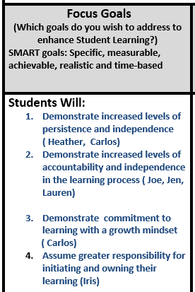
Focus Question: How can we foster an environment that is conducive to productive engagement for learning?
Teacher | Focus Area/Goal | Action/Strategies | Research and Resources | Pedagogical Documentation/Data to be Collected | Evidence of Success

Slide 14
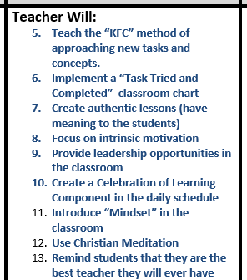
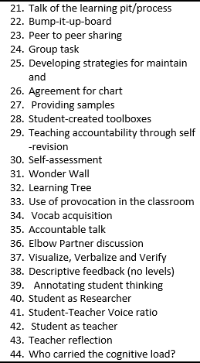
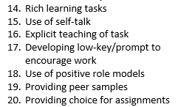
Focus Question: How can we foster an environment that is conducive to productive engagement for learning?
Teacher | Focus Area/Goal | Action/Strategies | Research and Resources | Pedagogical Documentation/Data to be Collected | Evidence of Success

Slide 15
Use of D2L Site for CITE
School-based usage
Invited CITE members to join D2L site
Posted all of our materials
Use of discussion board and blog
Future usage is being be explored
LINK: https://wcdsb.elearningontario.ca/d2l/home/6175296

Slide 16
Overall Perceptions of Participants
Valued opportunity to research and collaborate with colleagues
Loved the partnership and the professionalism.
Recognized time needed to dissect the question and focus before the action.
Gained insights from working with educators such as teachers, principal, board and university staff.
Felt like a celebration of learning
Liked to select individual goals from the collective focus and adjust strategies to meet classroom/student needs.
Appreciated the support given to teachers to nurture “ownership of learning” for students.

Slide 17
1. How does the collaborative inquiry process facilitate participants’ awareness and interest in the research process?
“I found today very useful and am looking forward to embarking on this research initiative”
“My mind was thinking in a way that engages me”.
“It was very helpful to go through each step in the research process and apply it to our area of focus”.
“I enjoyed seeing it in action with other colleagues”.
“The SURE videos provided real examples of collaborative research. They showed us that research can be easily conducted within a classroom setting.”
“I need to have a connection to the research. It needs to be related to my teaching; otherwise, I am not interested.”
“I appreciate the ability to gather results/change techniques and tweak strategies”
“We are recognizing that we need to take the time to really dissect the question and focus before we take action”

Slide 18
Through the Collaborative Process, teachers were able to:
Become aware of colleagues interests and educational issues
Take the time to reflect on their current practices and gather feedback from others about potential strategies
Discuss concerns and gather support from the various stakeholders around the table, including the SWS Teacher, Consultants, Principal and the University Research Team
Get to know their colleagues and also feel supported in acknowledging that some strategies may ‘not yet’ have worked
Gather feedback across divisions and create a common language and understanding between grade groups
“I really like the time we were able to show what our concerns were as were trying to gather questions for potential research. Hearing that other teachers are experiencing the same things I am feeling assures me I am on the right track.”
“The discussion and sharing ideas were the most valuable piece for me. I feel more confident in my abilities to achieve the goals, I have set for my students”.

Slide 19
Teachers competencies were increased by:
Recognize themselves as researchers.
Increase skill development in certain areas and add best practice strategies to their own instruction.
For some participants, this was the first time that they had reflected on how their classroom teaching might affect outcomes on the provincial assessments of grades three and six.
Teachers were given time to think CRITICALLY about their practice and how students learn and WHY they learn.
“I’ve thought more about my practice than I ever had before. How do I improve scores?”
“I am able to take time to critically reflect on my student learning and WHY they learn.”

Slide 20
How did this process enhance student learning and skills?
After data collection teachers took the time collaboratively within the CITE group to analyze the data and discuss any patterns or themes.
The changes in student learning and engagement related to persistence and task completion. This was demonstrated through teachers’ collection of pedagogical documentation and data such as work samples, student comments, time on task measures, photos and other authentic classroom assessments such as completion of rubrics and self-reflections.
The teachers indicated that there were marked improvements.
I have also noticed my students have gained a greater awareness of the importance of independence, persistence and grit.”
“Awareness is the key and reflecting on my practice has contributed to making changes to my teaching strategies.”
“Evidence was good ...physically seeing the progress of the students.”

Slide 21
Improved Student Learning
Inquiry Focus: Students improve perseverance and grit to complete tasks and increase stamina
Homework completion improved
Less reliance on teacher support
Greater number of students willing to share work
Increased time spent on independent work
Quantity and quality increased in choice assignments
Increase of 8 min to 20 minutes of work focus
Students created their own work list every day which resulted in less unfinished work/homework
“I can’t believe I wrote that much in that short period of time!”

Slide 22
Improved Student Learning
Inquiry Focus: Students demonstrate increased levels of accountability and independence in the classroom
More ownership in reviewing work
Increased pride in the draft process of writing
Begin to use the newly introduced rubric for their other activities
Started showing initiative by requesting the teacher for conferencing
Students acknowledged times when they were stuck verbally using the phrase “My brain is on fire” with a positive attitude
Did not “give up” when faced with a challenge
Demonstrated improvements in writing quality and length of writing produced
“I looked it over with the checklist and I KNOW it is ready to hand in!”
“I am not ready to give up. I am going to try another way first.”

Slide 23
Year 2 - CITE 2016
Monitoring? Pre & post qualitative data
Co-creation of revisited group norms
Teacher as Researcher
Systems Thinking
SIPSA – POP
Sharing of current research
Continuation of D2L site

Slide 24
CITE 2016

Slide 25
Concluding Thoughts
The following simple formulas reflect the main themes identified from the data analysis:
Teachers + Researchers = Teacher Researchers
Teacher Researchers + Knowledge Mobilization = School Engagement
School Engagement + Instructional Strategies = Student Learning
Beneficial and supportive collaborative partnerships
D2L site extensions are being explored further
Wider school participation and enhancement of CITE
Dissemination of findings and knowledge mobilization in journals, conferences, school board presentations…

Slide 26
Applications
Process of collaborative inquiry aligned with SIPSA using continuum of growth
Partnership with research component
MOE resources and SURE video series
WCDSB resources: D2L and Learning Commons
Structured Template for Action Plan
Teacher ownership and school-wide professional development
Mobilization of co-constructed knowledge

