Slide 1
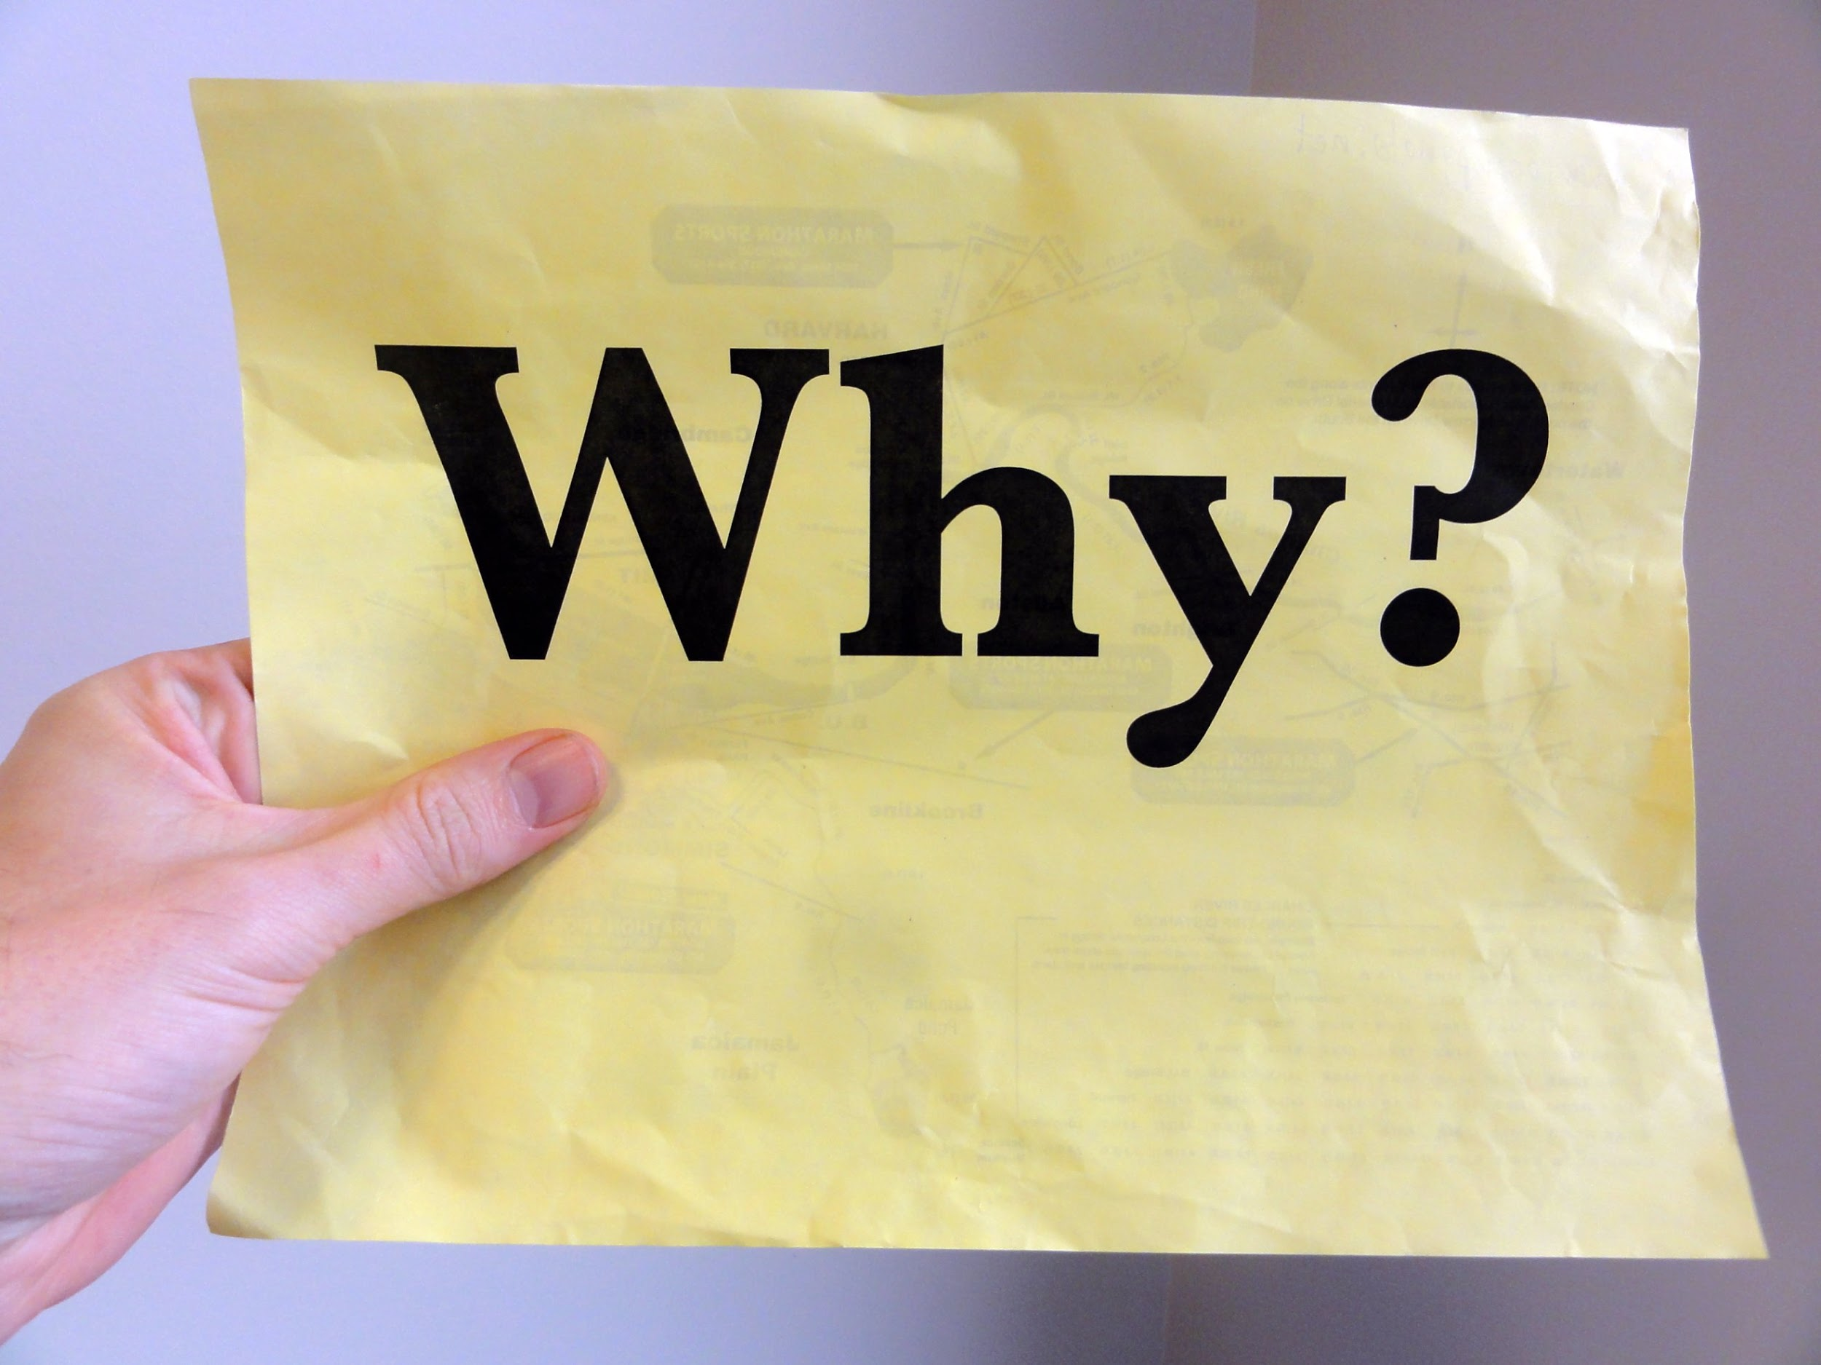
Simon Sinek
START WITH WHY
How leaders inspire Action
By: Heather Papp
Notes:
Katie - introduce the theorist to class

Slide 2
Learning Agenda
Inside Out Thinking
Ted Talks Video
Golden Circle
Explore the WHY
Reflective Activity
Notes:
Katie - go over agenda with group

Slide 3
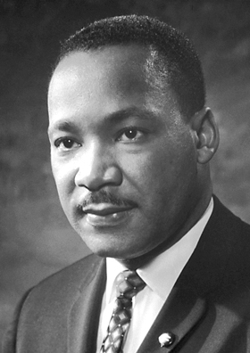
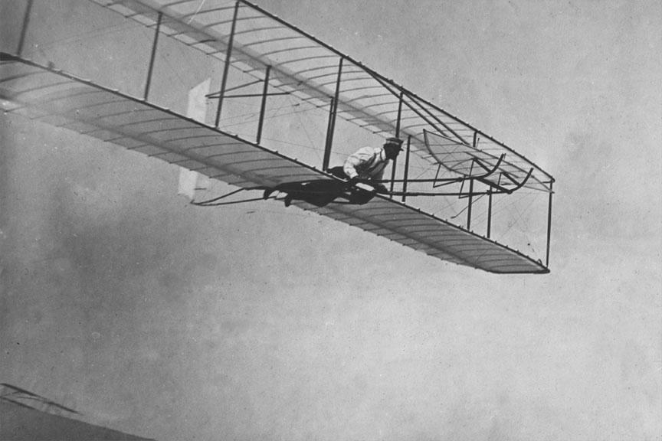
Why are some leaders more persuasive and
inspiring than others?
What inspiring qualities have cemented Apple, Martin Luther King Jr, and the Wright Brothers into their iconic status as leaders in spite of intense competition?
Notes:
Katie - present the question and then ask participants to Please turn to the person beside you to discuss this question. Take a few responses.

Slide 4
Simon Sinek believes that you must start with WHY!
In fact, these leaders
have utilized this
principle whether
knowingly or unwittingly.
The more you dissect
these great leaders, the
more noticeable the
pattern becomes.
Notes:
Katie
All great leaders have a following...maybe not at first but their inspiring and persuasive qualities help them to achieve this.
Whether they realize it or not, all great and inspiring leaders and organizations think, act and communicate in the same way... and it is the complete opposite from everyone else.

Slide 5
“WHY” Thinking...
In essence, leaders think differently. Simon believes that instead of the conventional “whatcentered thinking”, successful leaders have embraced a “whycentered thinking.”
Notes:
Katie
Simon Sinek wants people to move from “What centered” thinking to more of “Why centered” thinking. We will go further into this concept as we move through the presentation.

Slide 6
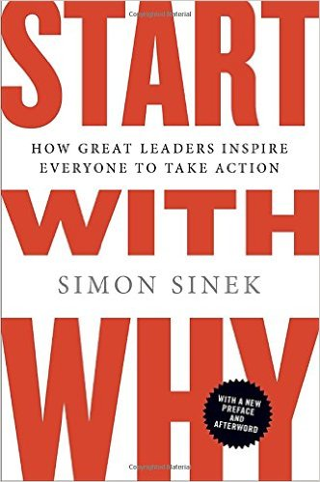
Ted Talks
Simon Sinek
Notes:
Heather This pattern is all outlined in Simon Sinek’s book, Start with WHY. We are going to watch a 5 minute clip that discusses his idea of starting with WHy and how this can change the way we think and communicate our thinking to become better leaders in our lives.

Slide 7
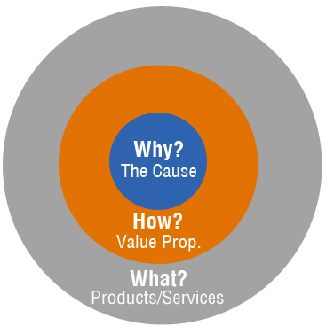
The GOLDEN CIRCLE
WHAT: Every single person on this planet knows WHAT they do. These are the services or products that they sell.
HOW: Some people know HOW they do WHAT they do. These are the things that make them special or set them apart.
WHY: Very few people can clearly articulate WHY you do what you do. Why is not about making money or improving scores. That is a result. WHY is a purpose, cause or belief. It is the very reason why your organization exists.
Notes:
Heather So from the video we start to get a better idea of what Simon calls “WHY” thinking.
Every single organization on the planet, whether that be in education or in business function on three levels:
1. What we do
2. How we do it, and
3. Why we do it.
Simon believes that when those three pieces are aligned, it gives us a filter through which to make decisions. It provides a
foundation for innovation and for building trust. When all three pieces are in balance, others will say, with
absolute clarity and certainty, “We know who you are,” “We know what you stand for.”
This simple idea is called The Golden Circle.
Read through the slide from the WHAT, HOW and WHY

Slide 8
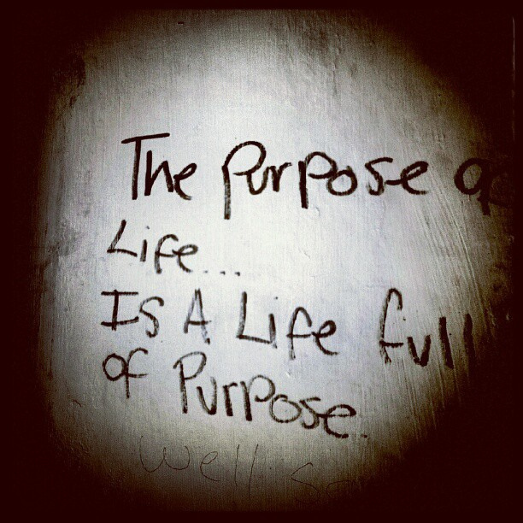
By starting with Why,
Sinek means starting
with purpose, cause,
or belief that drives
your What.
Your What my
change over time, but
your Why doesn’t.
Notes:
Heather
The overall idea is that if you are able to articulate and start with your WHY you do what you do, you will start to live a life with purpose and meaning that you are connected with

Slide 9
APPLE is a case in point...
Apple epitomizes the “why centered thinking.” See how Apple frames their messages.
“We make great computers.(WHAT) They’re beautifully designed, simple to use, and user-friendly.(HOW)
Want to buy one?” Doesn’t really sound compelling, does it?
Notes:
Heather
Simons book is really focussed on business ventures and many of the examples in the book related to business. But as he talks about product and results, this is easily relatable to education. We are all offering a service of sorts and we all have a vision or mission that recognize our values and ideals of what we want to see. Here is an example that Simon uses in his book about APPLE. This is the typical way that people market themselves….from the what to how and then why. But APPLE is different. They have a WHY centered thinking.
Read through slide

Slide 10
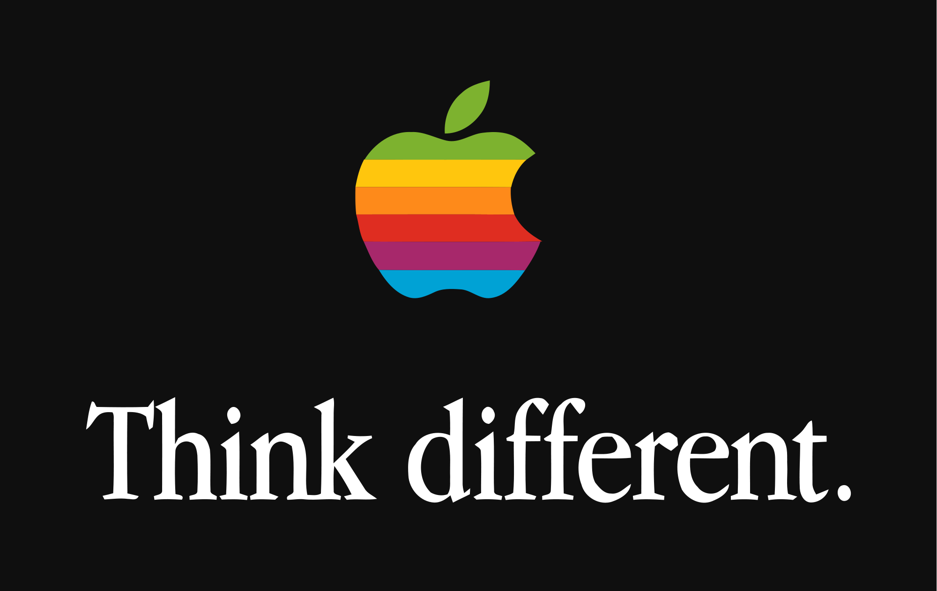
This is how Apple REALLY communicates...
“Everything we do, we believe is challenging the status quo, we believe in thinking differently.(WHY)
The way we challenge the status quo is by making our products beautifully designed, simple to use, and user-friendly. (HOW)
We just happen to make great computers. (WHAT)
Want to buy one?
Notes:
Heather
This is an example of the WHY centered thinking. There is a distinct difference. The feeling is different altogether. This is the type of thinking that Simon says will get you better results as a leader.

Slide 11
Golden Circle and the Human Brain
Notes:
Katie
The interesting part of the idea of the Golden Circle is that Simon states that it is rooted in simple biology. He draws a correlation between the Golden Circle and the human brain. If you were to cut the brain in half, both the Golden Circle and the brain share similar characteristics. They both have rings that identify the various levels of thought. The WHAT part of the Golden Circle relates to the NEOCORTEX of the brain. Both of these sections revolve around language and rational and analytical thinking.

Slide 12
Notes:
Katie
The HOW and the WHY sections of the Golden Circle relate to the LIMBIC BRAIN. These areas are responsible for all of our feelings, human behaviour and decision-making. This is the true “WHY” of what we do. It connects to our feelings which is what typically drives our motives and aligns with our values and instincts.

Slide 13
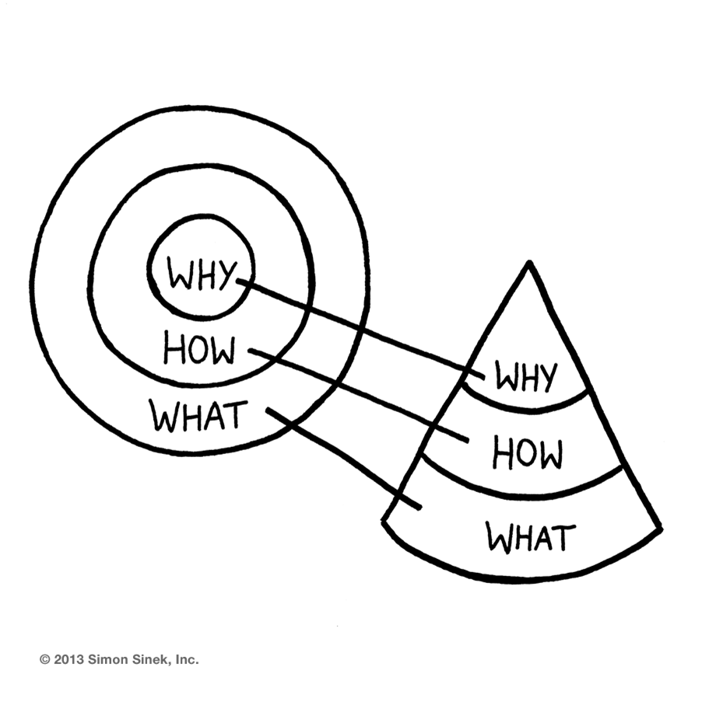
Golden Circle and the Cone
Notes:
Katie - shows a hierarchy of business model. Can be applied to leaders in education as well.
If the leader is clearly able to articulate the why, the how and what are easy to identify. We really want the leaders to know the why so they are able to infuse that thinking in all they do.

Slide 14
Golden Circle as a Megaphone!
Notes:
Katie
In this slide we turned around the cone to take the shape of a megaphone. Simon also discusses that they leaders who truly know their “WHY” should be shouting it out and making all decisions based on their WHY.

Slide 15
“The 5 WHY’s” Activity...
Why do you have a career in education?
Notes:
Heather
Explain activity - ask students to write down an answer to the question posed. Sticky notes will be placed at each seat. Once they have written down the ideas, we will continue to the slide with the video on it.

Slide 16
YOU-TUBE VIDEO - 5 WHYS
Notes:
Heather (NEED TO HAVE A TAB OPEN WITH VIDEO UPLOADED)
Introduce the video. Discuss that the video is an example of the activity we will look at doing with each other. Let students know that this video is from a comedy show and there are some parts that may seem inappropriate but the idea is that the format of asking whys is modelled.
Now we want you to air up with a partner share your answer. One person will go first and one will be the why person. We will allow three minutes for talking and then we will ring a bell and you will switch roles.

Slide 17
“The 5 WHY’s” Activity...
Notes:
Heather
Thanks so much for participating in the activity.
So, Did you happen to feel like this during this activity?

Slide 18
Notes:
Heather
What about this?

Slide 19
Discussion on 5“why’s” Activity...
How did you feel?
Was it easy for you?
Notes:
This activity was done to really get you thinking about your WHY. It can be a challenging task and it takes enormous effort to really reflect and think about your why. Simon believes that time must be invested to understand and have some clarity about your WHY before you can move forward and eventually be successful in your mission.

Slide 20
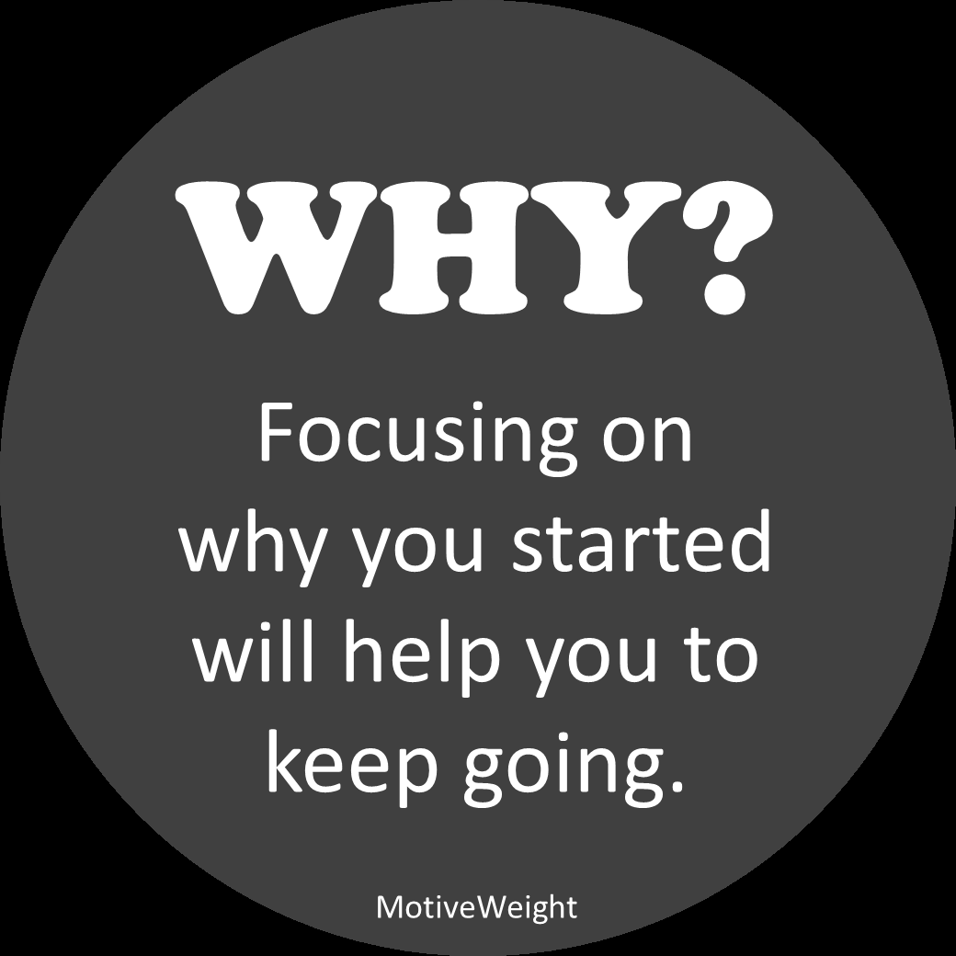
What’s your WHY?
When we start with Why, things change.
Our thought processes begin to change. We gain clarity around our why we do certain things. Why we choose this certain job over the other, why we spend time with family and friends…
Notes:
Heather
So to sum things up, Simon truly believes that we want to start with the why and base our decisions that we make as leaders on the why.
The hope is that when you focus on the why, it increases your motivation to keep going and moving forward.

Slide 21
A Paradigm Shift
That is, you must discover your purpose in life, how to utilize your spiritual gifts,talents, and potential to achieve your vision. Life must be seen from a larger scheme rather than from a focus solely on your career, family, or personal life.
Notes:
Heather
There have to be a paradigm shift. You must discover your purpose in life.

Slide 22
What’s Your Why?
We often take things for granted without thinking the reason behind the ‘what.’
We gain the opportunity to understand what truly matters –
the core of who we are, our unyielding conviction, belief, and purpose.
Notes:
Heather
The WHY is the core of who we are and why we do what we do.

Slide 23
Application to Leadership
Know your OWN why before you ask others to explore!
Start the beginning of the year with a “Finding Your Why” exercise with ALL staff (sheet to follow)
Get to know the “WHY” of all staff and keep it close so it can be referred to when issues may arise or when staff are needing extra support.
Create a visual representation for staff to post in their own classrooms as a reminder of their own personal WHY.
Notes:
Heather
Lastly, Katie and I spent some time thinking about how we can use this “WHY” thinking in the role of a future administrator.
Some ideas we came up with are: read the slide

Slide 24
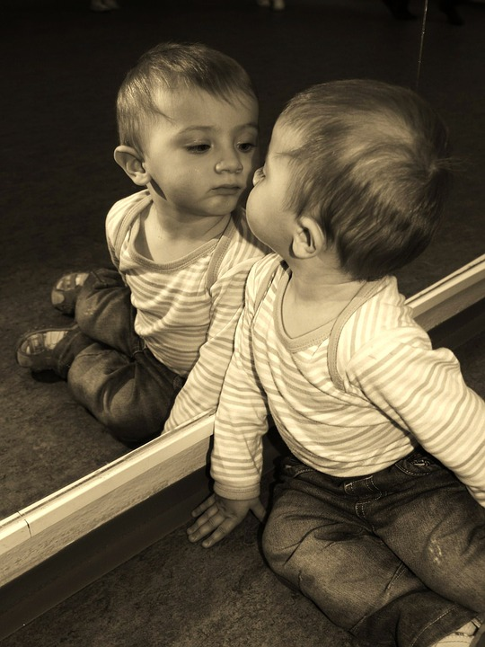
Hand out - Reflective Sheet Taking a look at yourself
Do you understand the true role of an educator?
As an educator, how do you measure your own success?
Why do you want to educate?
What is your WHY statement?
Notes:
Katie - we have created a basic worksheet that you can use with future colleagues to start to get them thinking about their own WHY. This would be an example you could use at the beginning of the year to get your staff thinking about why they do what they do

Slide 25
Resources on Google Drive
Notes:
Katie
All of the resources including the Powerpoint, reflection sheet, one pager summary are all uploaded to the google drive

Slide 26
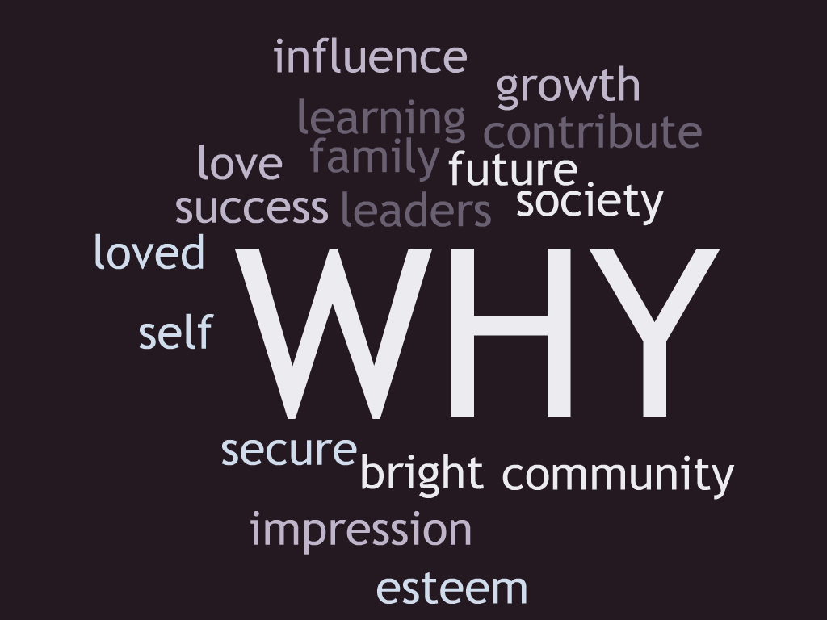
WORD CLOUD
Notes:
To end our presentation we wanted to also share with you that while we were doing that WHY activity, we were collecting a few words that we heard as you were talking to your partners and we quickly made a word cloud. This could easily be used with your staff as a visual representation and reminder of your WHY. We thought this would be a nice idea after a beginning of the year activity to get your staff to create a word cloud and post in their classroom or keep in a space that they could refer to when needed inspiration of their WHY. As you can see, these words naturally reflect our vision and our inner feelings of why we do what we do. When we have this solidified, we are in a better position to lead.

Slide 27
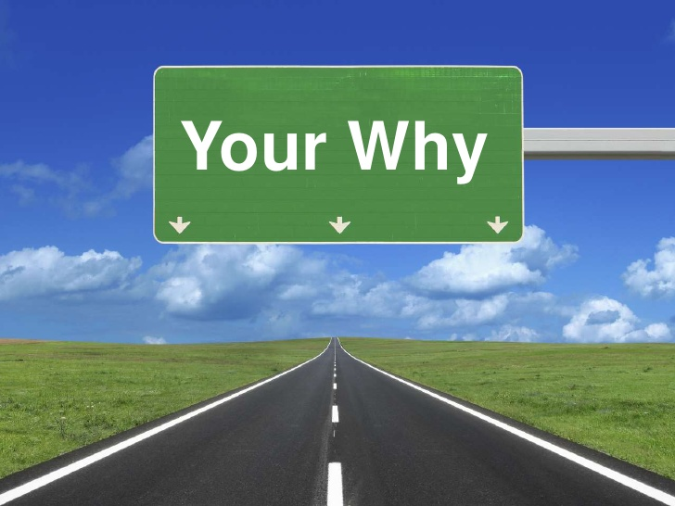
So here is the question of the day:
Why do you get out of bed every morning?
Notes:
So the question of the day is...why do you get out of bed every morning?

