Slide 1
Celebrating Summer Boost
St. Anne’s Site
Cambridge
Heather Papp

Slide 2
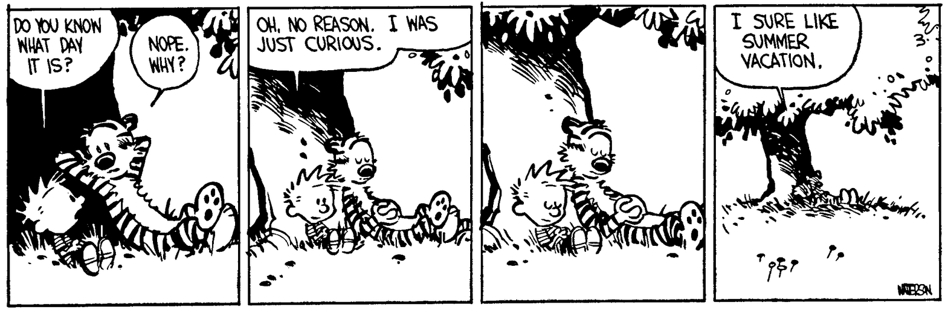
Focus of our planning centered around the following:
Students volunteered to be in school while their peers were enjoying their vacation
Learning had to be fun – almost a camp like atmosphere (games, activities and play)
Varied levels (differentiated instruction)

Slide 3
Structure of the Day
8:15-8:30 - Sign in – meet parents and students outside
8:30 – 8:40 - Morning Prayer and Nutrition
8:40 – 9:40 - Literacy
9:40 – 9:55 - Break
10:00 – 11:00 - Numeracy
11:00 – 11:20 - Break
11:20 – 12:20 - Creativity
12:20 – 12:30 – Celebration of Learning and Dismissal

Slide 4
Initial Diagnostic of Students
Students come from varied backgrounds
Students are learning at varied levels
Differentiation is important
Learning styles honoured
Numeracy Diagnostic – Leaps and Bounds
Literacy Diagnostic – Running Record Reading Level
Personal Interview – get to know each student

Slide 5
Literacy Program
Mentor texts taken from Literacy rooms at St. Anne’s
Staff met ahead of program to decide on texts to use
Texts were incorporated into all areas of learning including creativity and math
Summative task based on mentor text
Bulletin Board creation
Use of technology – abcya.com

Slide 6
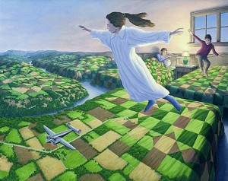
Mentor Text
Descriptive writing
Vivid language
Created clay sculptures of scenes from text
Wrote about the scene using vivid and descriptive language
Clay Museum
Geometry and spatial sense (students identifying shapes)
Transformations
Dance – moving bodies into varied shapes from the text

Slide 7
Numeracy Program
Leaps and Bound – Marian Small
Explorative math – outside estimating how many leaves, proportional reasoning, cooking fractions
Inquiry based
Games based – race to 10, create the largest number
Use of manipulatives and technology
Math Prodigy online game

Slide 8
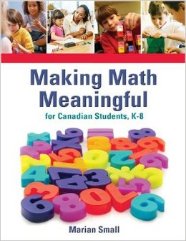
Diagnostic was given from Leaps and Bound
Gaps were identified
Strands were chosen based on need
Games based approach with lots of inquiry and problem solving opportunities

Slide 9
Assessment Practices
Final assessment from Leaps and Bounds strand covered
Show what you know approach
Literacy reading levels tested
Exit interview with students
Scrapbook of learning

Slide 10
Celebration of Learning
http://www.cambridgetimes.ca/news-story/4635067-getting-a-summer-boost/
Learning is celebrated at the end of each day – highlights from each group
“I feel like we are not even learning. This is fun!”
“Do we have to go home now?”
“I can’t wait to show my mom that I can multiply!”
“Can I take this book home to read at night. I will bring it back, I promise!”
Attendance was strong and smiles were everywhere

