Slide 1



No Place Like Home
Teaching Students who struggle with poverty and homelessness

Slide 2
Outline
Welcome
  Introductions
Why talk about poverty in the classroom?
The truth about poverty and homelessness
Basic suggestions for guiding classroom learning
Lesson plans
Community action ideas
Teaching resources
Shelters
Supporting students living in poverty
Questions & feedback

Slide 3

About me:
    Currently teach at the Intermediate level at a lower economic school in Cambridge
    Social service worker for 12 years servicing marginalized families living in poverty
    Completed my Masters thesis on “The effects of homelessness on education.”

Slide 4
Goals of Workshop:
  Raise awareness and empathy for families and kids living in poverty
  Identify stressors commonly experienced by children and youth living in poverty.
  To equip teachers with practical resources and suggestions for teaching students about poverty and homelessness
  To describe strategies for working with students living in poverty
  Introduce Teacher Toolkit

Slide 5
Group Activity
“3 STATES OF HOMELESSNESS“
Absolute
Hidden
Shelter
Notes:
Think/Pair/Share – Topic #1 Absolute Homelessness (living on the streets)
Topic #2 - Hidden Homelessness (staying with friends and family but do not have your own address)
Topic #3 - Shelter (emergency shelter). Have them brainstorm what it might be like to live in that situation according to their previous knowledge on the topic. How might living in this situation affect their school life?
Have the group brainstorm together. Use chart paper or a white board to write down the words that everyone shouts out. Point out that today these common views of homelessness will be discussed further. This is also an idea for a lesson starter in a classroom.

Slide 6
What might it be like to live in any of these situations?
How might it affect school life?
Notes:
Think/Pair/Share – Topic #1 Absolute Homelessness (living on the streets)
Topic #2 - Hidden Homelessness (staying with friends and family but do not have your own address)
Topic #3 - Shelter (emergency shelter). Have them brainstorm what it might be like to live in that situation according to their previous knowledge on the topic. How might living in this situation affect their school life?
Have the group brainstorm together. Use chart paper or a white board to write down the words that everyone shouts out. Point out that today these common views of homelessness will be discussed further. This is also an idea for a lesson starter in a classroom.

Slide 7
Why talk about poverty and homelessness in the classroom?
Social issue of local and national relevance
Promotes an appreciation for diversity and inclusiveness
Students develop empathy, compassion, moral reasoning, and critical thinking skills
Notes:
Curriculum connections
Religion, Social Justice, Mathematics, Character Education, Language, Social Sciences, Economy, Family Studies, Nutrition

Slide 8
“Children who experience poverty, especially persistently, are at higher risk of suffering health problems, developmental delays, and behaviour disorders. They tend to attain lower levels of education and are more likely to live in poverty as adults.”
- Dominique Fleury, “Low-Income Children,” Perspectives on Labor and Income 9, 5 (Ottawa, Statistics Canada, May 2008)

Slide 9

The truth about homelessness
Based on "Myths and Facts" document created by the Cambridge Action on Homelessness Group
Adapted into a "The Truth about Homelessness" worksheet for classroom use (in Toolkit)
Great classroom tool for introducing the topic and addressing stereotypes
Notes:
This presentation of information is designed to increase the confidence of teachers in regards to the subject of homelessness.
The following series of True/False questions are a great way to dispel myths about homelessness and poverty in your classrooms. It is a great way to give background information on the topic. We will start with this list today and work our way through it so we will all have a better understanding of poverty and homelessness in Canada.

Slide 10
The truth about homelessness
There are people who don’t have a home.
True / False
1 in 10 Canadians is considered “poor”
Homelessness is a big issue for many communities all across Canada.
Many others choose not to stay in shelters and "hide" their homelessness by staying with friends or families.
Notes:
Homelessness is a big issue for many Canadian cities. The number of people who stay at emergency shelters is one way to measure homelessness. This does not include people who choose not to stay at shelters or who “hide” their homelessness by staying with friends or family.

Slide 11
The truth about homelessness
People choose not to have a home. They could get a home if they wanted to.
True / False
No one chooses to be homeless and most people want a home.
It is hard to find a home that people can afford.
There are long waiting lists for supports to help people keep their housing.
Notes:
No one chooses to live in poverty. Most people are shocked when it happens to them. Most people who live in poverty want to get out of it. However, it is very hard to do. Some people who live in poverty become homeless. In order to keep their homes, some people also need extra support, like nursing care. There are long waiting lists for these supports.

Slide 12
The truth about homelessness
There are children in Canada who don’t have a home.
True / False
When parents are poor, children are usually poor.
Many more children experienced hidden homelessness.
Notes:
There are people of all ages and genders who don’t have homes in all cities across Canada. Many children are raised in poor homes and suffer a great disadvantage. Many children live in shelters and but many more experience hidden homelessness.

Slide 13

Families are the fastest growing group of people experiencing homelessness in Canada.

Slide 14
The truth about homelessness
People who are poor are lazy and don’t work.
True / False
Things are not easy for people who are poor.
Some people who are poor have jobs and many others want jobs.
It can be hard to find a job for reasons like health concerns.
Notes:
People who are poor often have to work very hard to get their basic needs met. Also, many people who don’t have a job, want to get jobs. Some people without homes have jobs. Other people have a hard time finding a job for reasons like health concerns. The current state of the economy also puts many people at risk of homelessness and keeps poverty levels high.

Slide 15
Income Inequality Video

Slide 16
The truth about homelessness
All people living in poverty are addicted to drugs or alcohol.
True / False
Some people living in poverty use substances like drugs or alcohol.
Many other people do not.
Notes:
Some people who live in poverty use substances like drugs or alcohol. Many other people living in poverty do not use substances like drugs or alcohol.
There are not enough supports to help people with addictions issues.

Slide 17
The truth about homelessness
Homelessness only happens in big cities.
True / False
There are people who don't have a home everywhere.
Notes:
There are people who don’t have homes everywhere. In smaller towns and villages, there are fewer formal programs like shelters to help people who don’t have a home. In these areas, people might experience “hidden homelessness”. In cities, people who don’t have homes can more easily find emergency shelters and supports for their housing.

Slide 18
The truth about homelessness
If we had more homes there would be no homelessness.
True / False
To end homelessness, people need stable homes, income, and supports.
Notes:
To end homelessness, people need more than just stable homes. They also need income and supports. People need a safe and secure home that they think is right for them. They also need enough income to meet their basic needs, such as shelter, food, clothing, and transportation. People also need different types of support, both from people they know and other people in the community to keep their homes for a long time. Homelessness can be ended with these three things—housing, income, and supports.

Slide 19
The truth about homelessness
There is nothing we can do about poverty and homelessness.
True / False
Everyone has a part to play in ending poverty and homelessness.
There are many ways classrooms can get involved including: letter writing; donating supplies; volunteering; and informing others. These ideas will be discussed in detail later.
Notes:
Everyone has a part to play in ending poverty and homelessness. Students can help by writing letters to leaders asking them to support poverty reduction plans. You can also donate your time to an organization working to support people living in poverty. Lots of these organizations also need donations of supplies like shampoo and socks to support people who don’t have a home. Finally, you can tell others about why people live in poverty and the things that can be done to make sure that everyone in Canada has a home.

Slide 20
``Poverty is like punishment for a crime you didn't commit. ``
~Eli Khamarov

Slide 21
Basic suggestions for guiding classroom learning
Acknowledge sensitive nature of issue
Introduce topic to parents
Encourage questions and open discussion
Counter stereotypes—could begin discussion with questions from "The Truth about Homelessness" worksheet

Slide 22
Basic suggestions for guiding classroom learning
Respectful language is important
Use “person-first” language, acknowledging homelessness as a (usually) temporary state of being
  “person experiencing homelessness” is preferred over “homeless person”
  for children, “someone who doesn’t have a home” is preferred over “homeless person”
  “person with a mental health issue” is preferred over “mentally ill person”
Notes:
Using person first language helps restore the dignity of the person rather than focussing on their current situation of being poor or homeless.

Slide 23
Reflection
1. Think about a time in your school or community where someone was judged based on their income level or where they lived?
2. Does anyone know of any initiatives that are taking place in schools to support people living in poverty?

Slide 24

How can we help our students living in poverty succeed in school?

Slide 25
In order to help…
Teachers must first look at their own understanding and beliefs about poverty.
Our understandings of poverty are strongly influenced by preconceptions and attitudes, which may be the result of negative media attention reports and limited contact with people living in poverty.
It could be difficult to put yourself in the shoes of another who is poor if you have never experienced it or had contact with other individuals who are living in poverty.
Notes:
We have spent the first part of this workshop discussing what poverty looks like. We have tried to dispel myths and show the face of poverty. In order to support those who are struggling we must throw out all preconceptions and beliefs about poverty and listen to our students.

Slide 26

Supporting students living in poverty
Signs of a child living in poverty:
  Poor health and nutrition
  Poor hygiene
  Low self-esteem
  Unwillingness to form relationships with peers
  Difficulty trusting people
  Short attention span
  Aggression
Notes:
There are possibilities that you will support students in your classroom that are living in poverty and some that may be experiencing homelessness.

Slide 27
Ideas for discussing shelters with students
Get photos of shelter life, tour a shelter, or invite a speaker from a local shelter
Possible discussion starters:
  Privacy/ personal space
  Ownership
  Control over TV, noise, etc.
  Stability
Notes:
What would it be like to share a space with many other families?
Not to watch your favourite television show?
Not have a space to play outside, do homework or store your favourite belongings?
What happens to your pets when you have to move to a shelter?

Slide 28
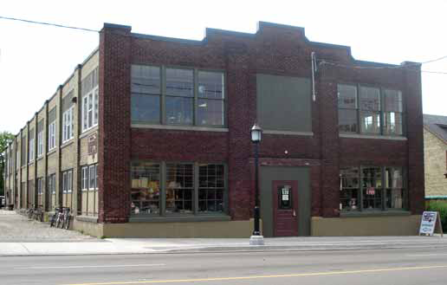
Living in Shelters
A shelter can be a room in a church or temple, school, or other type of building.
A homeless shelter can be a scary place for a child/youth.
Despite the dedication of people who work at shelters, many shelters are noisy, too hot or too cold, crowded, and lack many comforts.
Children sleep in the same room with their parents, and sometimes in the same room with people they do not know.
Bathrooms must be shared.
There may be no place for children/youth to play or do their homework.
Notes:
For those students living in homeless shelters, we must pay special attention to support these students. Liaise with the shelter staff should happen quickly and all should be involved to ensure consistency in care.

Slide 29
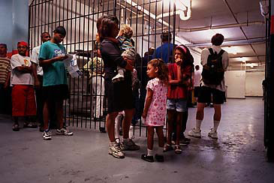
Living in Shelters
Shelters are usually designed to provide only a few weeks of emergency housing.
As the number of families becoming homeless increases, more and more shelters are forced to provide long-term housing for families with no place else to go.
Many families who are homeless are not able to live in shelters because there are none where they live or the local shelters are full.
These families are forced to live in cars, at campgrounds, or doubled up with their friends or relatives.

Slide 30
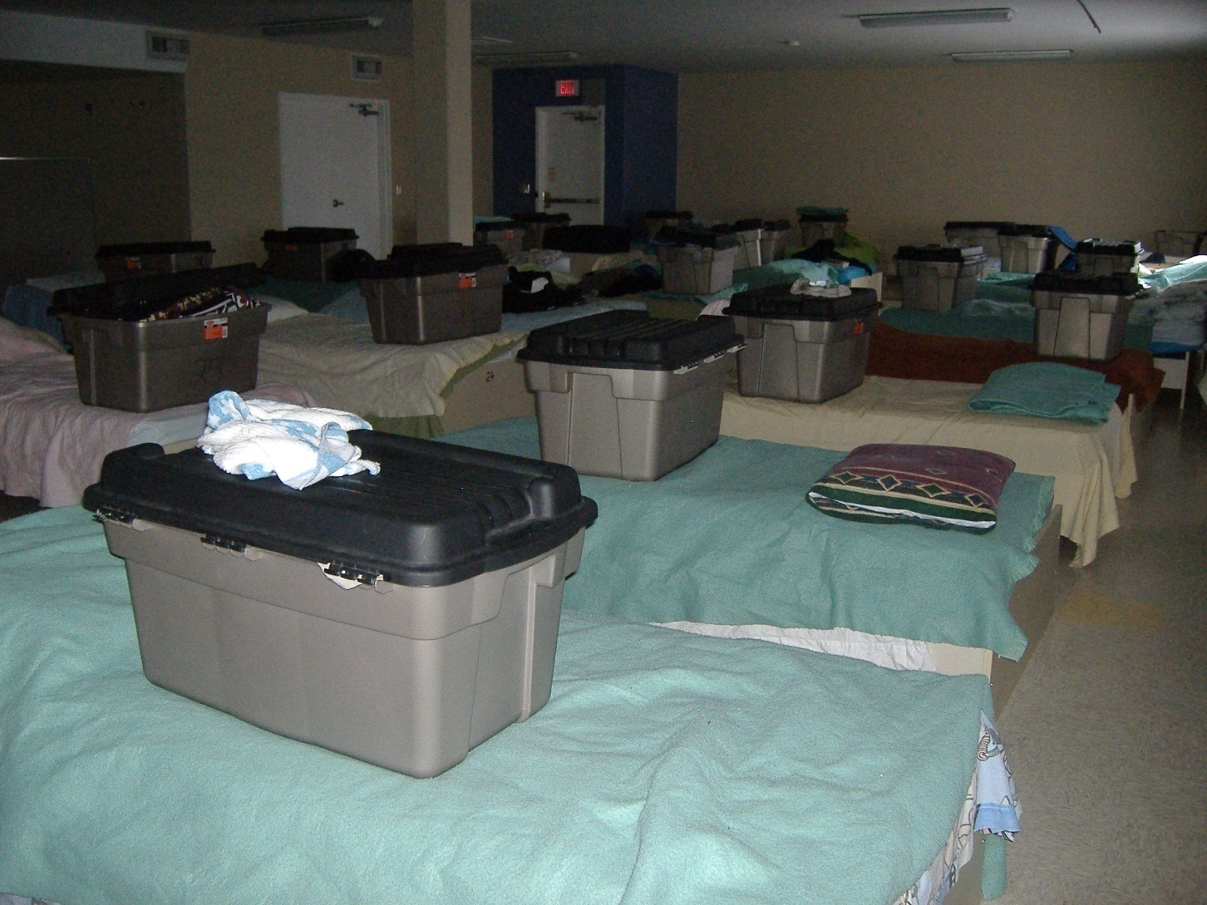
Imagine doing homework in an environment like this?
Notes:
Discuss elements of shelter life such as lack of privacy, noise, limited belongings.

Slide 31
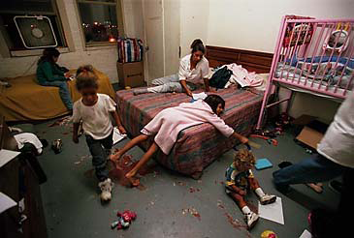
Or this...
Cambridge Shelter
Notes:
Discuss elements of shelter life such as lack of privacy, noise, limited belongings. Insert photos of family shelter rooms if available.

Slide 32
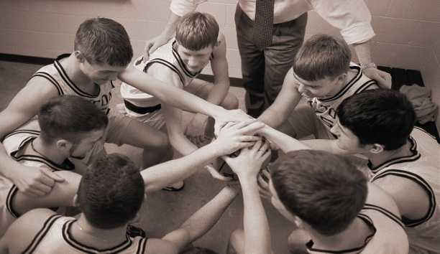
Students living in poverty may:
Need positive Relationships
You can help by:
Facilitating a sense of belonging

Slide 33
Strategies you can use:
Providing cooperative learning activities
Assigning a welcome buddy to support transition to a new environment
Providing activities that promote acceptance and diversity
Maintaining a relationship when the student leaves by providing self-addressed stamped envelopes and stationary
Offer a get-to-know you questionnaire or journal assignment. When students feel they belong they feel some ownership in thrive new room.

Slide 34
Prepare a short simple written list of classroom rules and procedures.
Replicate beginning of the year rituals and procedures when new students enter the classroom so they receive the same orientation to the school culture as other students.
Give new students a faculty and peer mentor/buddy.
Give new students a small welcome gift that shows the school colors and/or team name to invite them to share school spirit and pride.

Slide 35

Students living in poverty may:
Move frequently and lack educational program continuity
You can help by:
Addressing special learning needs

Slide 36
Strategies you can use include:
Immediately begin to plan for the next transition
Assessing present academic levels quickly
Providing necessary remediation/tutoring
Upholding challenging academic expectations
Contacting the school previously attended to help with placement decisions.
Following up on special education referrals or services
Reminding parents to keep copies of educational records and IEPs to share with a new school upon arrival.
Ensure that literacy assessments happen immediately so that the child is placed at the right reading level right away.

Slide 37

“Sometimes they may need testing but never seem to stay in the same place long enough to get testing. We have children that had they been more stable might have been assessed somewhere but – do we put them on the list - when they are going to be gone soon? Even when you put them on the list they have moved on. They tend to be more transient over their school career. Quite often they don’t get the assessment and testing that is required. “
- Teacher

Slide 38
Students living in poverty may:
Often come to class unprepared
You can help by:
Meeting basic needs in the classroom

Slide 39
Strategies you can use include:
Providing school supplies if necessary (pencil, paper, etc.) that can be shared with the student privately
Making sure that the student has a class job/role
Avoiding the removal of student possessions as a disciplinary measure
Sharing a set of texts for each grade level with the local shelter
Post a class schedule so students will know what is happening next.

Slide 40
Keep extra copies of review materials and assignments for students who arrive without prior notice.
Keep a supply of nutritional snacks in your room.
Keep needed toiletry items on hand to assist the student in maintaining proper hygiene if needed.

Slide 41
“The other thing is the kids leave all of their stuff behind at the other school. For the first time this year, a teacher sent stuff on. I gave the student an envelope with all of her stuff from her other school and she was so happy. It was the first time I saw her so happy, and you could feel that she had a sense of relief. She was like, “I got my stuff, here is my stuff.”
- Teacher

Slide 42

Students living in poverty may:
Often have high levels of depression, anxiety and low self-esteem due to the stress of living in poverty
You can help by:
Addressing these needs and related behavioral concerns

Slide 43
Strategies you can use include:
Reinforcing positive behaviors
Teaching and modeling skills such as problem solving, critical thinking and cooperative learning
Supporting and recognizing individual accomplishments
Maintaining the privacy of the child
Letting the student know you are glad he/she is there
Helping the student identify selected work samples and assemble a portfolio
Enlisting support of community organizations and health and social service agencies
Enlisting services of school personnel (eg. School counselor, school psychologist)

Slide 44
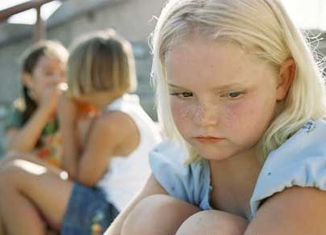
“Sometimes, instead of being aggressive, students actually withdraw. They don’t talk to anyone, they don’t talk to you, they don’t do anything. They are trying to blend into the wall but everyone notices, because they aren’t doing anything. And it is hard to talk to them after that. You have to really engage them to bring them out a little bit.” -Teacher

Slide 45

Students living in poverty may:
Live in shelters and homes that house more than one family and are noisy
You can help by:
Compensating in the Classroom

Slide 46
Strategies you can use include:
Providing quiet time during school hours
Having a “New Student Packet” containing a few school supplies and a welcome card from the class, for all new students
Allowing a child to do homework at school
Assigning a student a personal space
Having a “safe place” for student belongings
Give the student a clipboard to take home to use as a portable desk for doing homework

Slide 47

“I’m 16 years old. My brothers are 8 and 10 and my sister is 4. It’s just my mom and us kids. Landlords tell my mom they will not rent to families with more than three children. My uncle lets us sleep on the floor in his apartment. My brothers and I miss a lot of school because we don’t sleep very well at night. My back hurts and my uncle is up at night making noise so I can’t sleep. When I do go to school my teacher yells at me a lot for not paying attention. I try to pay attention in class but she never sees me trying. I am just so tired.``
-Student

Slide 48

Students living in poverty may:
Have parents who may be embarrassed by there poverty
You can help by:
Respecting and supporting parents

Slide 49
Strategies you can use include:
Making parents feel valued as partners in their child’s education
Providing parents with assessment results and related goals and objectives prior to their next move
Send notes home highlighting good behavior and work as well as concerns.
Providing an informal support system in which they feel it is safe to discuss parenting issues and concerns
Allowing parents extra time to pay for trips or assisting in accessing resources to help pay for special events
Helping parents become familiar with services available for homeless students, including outside agencies.

Slide 50

I’m in ninth grade. We’ve moved so many times, I’ve gone to 10 different schools. I’m not a very good reader, and I have a lot of trouble understanding math. I get mad a lot at school, and I’m always in trouble. You’d be mad, too, if you didn’t get to stay in one place long enough to make friends. I just wish we could have a house with a backyard where I could play. Then maybe I could catch up at school and have my friends over.``
- Student

Slide 51
Think, Pair, Share
Name a couple of strategies that you can feel you can implement in your classrooms immediately that would have impact on students living in poverty

Slide 52

Supporting students experiencing homelessness
Any reactions, questions, or comments?

Slide 53
Introduce Toolkit
Notes:
Toolkits are located on your tables. They are filled with discussion starters and lesson plans to help you approach the topic of homelessness in your classrooms. The larger discussion of poverty easily fits within this homelessness curriculum.

Slide 54
Lesson plans
Teacher Toolkit:
  2 lessons per division
  Detailed introductory lessons
  Linked with curriculum expectations
  Background information on homelessness
  Parent Communication

Slide 55
Lesson plan examples
Grades 7-8:
  Students read a case-study about a local family who doesn't have a home. They use the internet and phone book to identify community resources which could meet the family's needs.
  Students role play scenarios of conflict within families and resolve the scenarios. This is linked to a discussion of how youth can experience homelessness.

Slide 56
Lesson plan examples
Grades 9-12:
  What makes a house a home – class activity where students identify important aspects of having a home. Students then are forced to think about what it feels like when these are taken away.
  Continuum of Homelessness – class activity that identifies the three states of homelessness and students research local resources to support families/youth facing homelessness.
  Making ends meet on Ontario Works – students are asked to create a budget based on a case study. Students are then asked to come up with their own budgets to see if they would be able to make ends meet while on social assistance.

Slide 57



Community action ideas
Advocate:
  Write letters to elected officials
Donate:
  Collect funds or supplies that are needed by emergency shelters or outreach workers
Volunteer or Tour
  Find out if there is something your class could do that would help an agency (i.e., make posters)
Inform others:
  Organize an assembly with a speaker
Notes:
Students are motivated by action items and here is a list of a few.

Slide 58
Teaching resources
Picture Books
  Fly Away Home—Eve Bunting (1993)
  Uncle Willie and the Soup Kitchen—DyAnne Disalvo (1991)
  A Shelter in Our Car—Monica Gunning (2004)
  The Lady in the Box—Ann McGovern (1997)
Novels
  Monkey Island—Paula Fox (1991)
  Looking for X—Deborah Ellis (1999)
  Also known as Harper – Ann Hayward Leal (2009)
Notes:
Bring copies of the books to show teachers. Provide a brief overview if time allows. Books that are not used in the lesson plans could be highlighted.

Slide 59

Teaching resources
Music (suitable for grades 7 to 12)
  Another Day in Paradise—Phil Collins (1989)
  Moments—Emerson Drive (2007)
  Nobody’s Home – Avril Lavigne (2004)
Videos
  Land Before Time (1988)
  Pursuit of Happyness (2006)
Websites for more information
  www.hhug.ca
  www.homelesshub.ca/
  www.etfo.ca/Resources/ForTeachers/ → search “Home Free”

Slide 60
Final Thoughts
Poverty is a nightmare that can leave permanent scars. It devastates children’s education, health and self-esteem. It strains family relationships. It brands children with the stigma in the eyes of their peers.
Yet these children somehow seem to endure it and still retain their hopes and dreams for the future, and they should. They can succeed and teachers have the ability to teach them that they have the power to do so.
Teachers can show all students that they are worth something and that their living situation does not carry a death sentence. It is our responsibility, but more importantly, our privilege to do so.

Slide 61
Students define poverty video

Slide 62

Questions, comments or feedback?

Slide 63
Thank you to YOU! You have taken the time out of your busy schedules to learn about supporting children who might not otherwise have a chance to reach their full potential! You should applaud yourself.
Please feel free to share the information you learned today with your peers and coworkers. I hope you will!

